Slide 1

Webmethod.io
이진태

Slide 2



https://blog.naver.com/ilikebigmac
https://www.facebook.com/Taeknical/
https://github.com/TAEKnical

Slide 3
INDEX
What is the Webmethod.io ?
How it works?
How to use?
Conclusion

Slide 4
What is the Webmethod.io ?

Slide 5




What is the Webmethod.io ?
데이터 처리
Application/Service 자동화
Integration Environment
H O W ?

Slide 6
What is the Webmethod.io ?
H O W ?
Need Devloper

Slide 7
What is the Webmethod.io ?
H O W ?
Need Devloper

Slide 8
What is the Webmethod.io ?
iPaaS

Slide 9

What is the Webmethod.io ?
Notes:
webMethods.io Integration is a powerful integration platform as a service (iPaaS) that enables you to automate tasks by connecting apps and services, such as Marketo, Salesforce, Evernote, and Gmail. It lets your favorite apps exchange data and talk to each other seamlessly, and eliminates the need to hire expensive developers to build your favorite integrations.
Use webMethods.io Integration for faster business implementation of SaaS applications, to lower the TCO(Total Cost ownership) by eliminating maintenance and upgrade projects, and for self-service integration where expertise is not required.

Slide 10
2. How it works?
Notes:
webMethods.io Integration is a powerful integration platform as a service (iPaaS) that enables you to automate tasks by connecting apps and services, such as Marketo, Salesforce, Evernote, and Gmail. It lets your favorite apps exchange data and talk to each other seamlessly, and eliminates the need to hire expensive developers to build your favorite integrations.
Use webMethods.io Integration for faster business implementation of SaaS applications, to lower the TCO(Total Cost ownership) by eliminating maintenance and upgrade projects, and for self-service integration where expertise is not required.

Slide 11
2. How it works?
Project
Workflow
FlowService
FlowService
Constructs
Trigger
Action
Connector
Notes:
A trigger is something that fires off a workflow, and actions are the tasks that the workflow performs automatically.
Whenever you post a new tweet in Twitter, send the tweet content to a Slack channel.
Trigger → When you post a new tweet in Twitter
Actions → Post it on Slack channe
These connectors allow you to connect to the SaaS providers.
This allows you to run a specified sequence based on a field value, try a set of steps, and catch and handle failures. The panel displays conditional expressions, looping structures, and transform pipeline. Conditional expressions perform different computations or actions depending on whether a specified boolean condition evaluates to true or false.
This enables you to invoke other FlowServices from the current FlowService. The input and output of the referred FlowService must be accordingly mapped for a successful execution.
FlowService 에서 text를 찾거나, 주고받는 데이터를 debug하거나, 실시간으로 FlowService를 테스트 해보는 등의 동작 가능.

Slide 12

How it works?
Project
Notes:
project는 폴더와 같음
사용자가 생성한 asset, workflow, flowservices가 이 안에 들어있음
계층으로 치면 webmethod.io에서 두 번째 계층. 최상위는 계정.

Slide 13

How it works?
Project
Project
Project
Project
Project
Project
Notes:
project는 폴더와 같음
사용자가 생성한 asset, workflow, flowservices가 이 안에 들어있음
계층으로 치면 webmethod.io에서 두 번째 계층. 최상위는 계정.

Slide 14
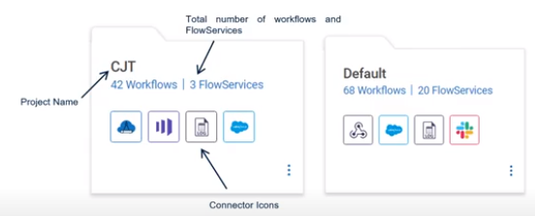
How it works?
Notes:
project는 폴더와 같음
사용자가 생성한 asset, workflow, flowservices가 이 안에 들어있음
계층으로 치면 webmethod.io에서 두 번째 계층. 최상위는 계정.

Slide 15
How it works?
Workflow is to connection between two or more web apps or services.
Notes:
webMethods.io Integration will automate the execution following the workflow.
In simple words, creating a workflow is like defining your conditions: When an event occurs in ‘Service A’, do something in ‘Service B’, and (optionally) pass on the data to ‘Service C’, ‘Service D’, and ‘Service E.
webMethods.io Integration offers hundreds of web services for workflows. With the help of these, you can create custom workflows by defining triggers and actions, and automate almost every aspect of your work life.
When a new note is created in my Evernote account, translate the note in Spanish (using Google Translate Text), and send the translated text to my Gmail account. or
When a new bug is created in Projects, create a new card in Trello, and send me a text message on my mobile phone.

Slide 16
2. How it works?
A FlowService step is a basic unit of work that webMethods.io Integration interprets and executes at run time
Notes:
A trigger is something that fires off a workflow, and actions are the tasks that the workflow performs automatically.
Whenever you post a new tweet in Twitter, send the tweet content to a Slack channel.
Trigger → When you post a new tweet in Twitter
Actions → Post it on Slack channe

Slide 17
3. How to use?

Slide 18
3. How to use?
Project
Workflow
Trigger
Action

Slide 19
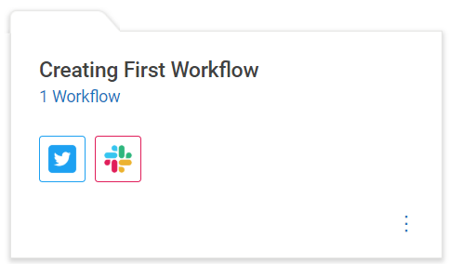
3. How to use?

Slide 20
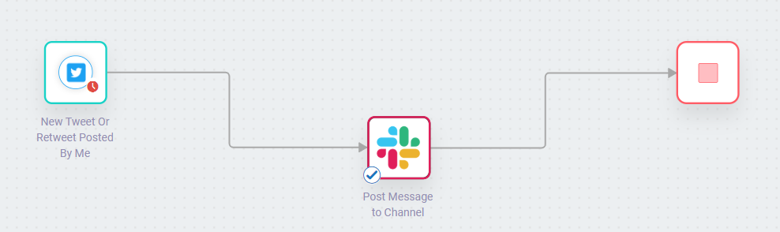
3. How to use?

Slide 21
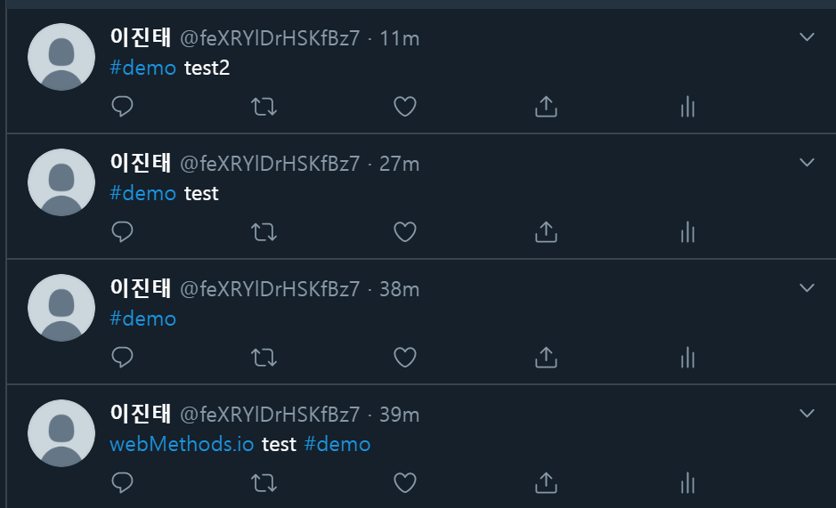
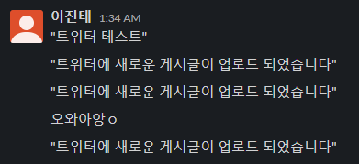
3. How to use?
Notes:
실시간 처리

Slide 22
4. Conclusion

Slide 23
4. Conclusion
서비스 간 실시간 데이터 송수신과 그에 따른 구체적 동작을 정의할 수 있다.
Webmethod.io 자체적으로 많은 서비스간 연동을 지원한다.
단, 지원하지 않는 서비스간 연동은 불가능한 것으로 보인다.
유명 서비스들은 이미 자체적으로 API를 제공하는 경우가 많기 때문에 간단한 동작정도는 생각보다 쉽게 구현할 수 있을 것 같다.

Slide 24
ㄲ ㅡ ㅌ

